Slide 1

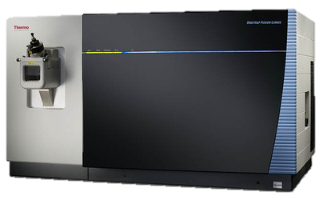
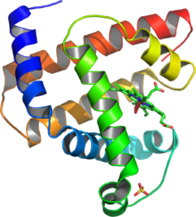
Max. speed
Max. torque
Engine power
Wheel base
Suspension
Tyre aspect ratio
Duty cycle
Mass accuracy
Mass resolution
Vacuum depth
Sensitivity
reproducibility
$$
TOP
DOWN
& unknowns

Slide 2

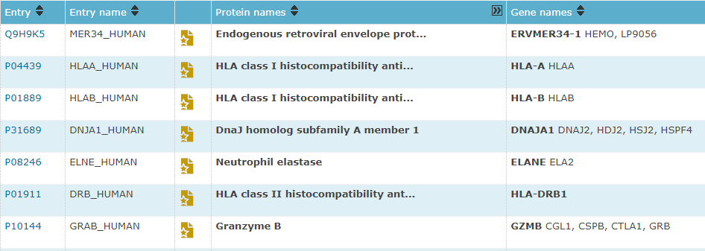
error tolerance
mass + ε
+ isoforms

Slide 3
Max. speed
Max. torque
Engine power
Wheel base
Suspension
Tyre aspect ratio
Duty cycle
Mass accuracy
Mass resolution
Vacuum depth
Sensitivity
reproducibility
$$
TOP
DOWN
& unknowns
AVERAGE
MASS
= a lousy statistic

Slide 4
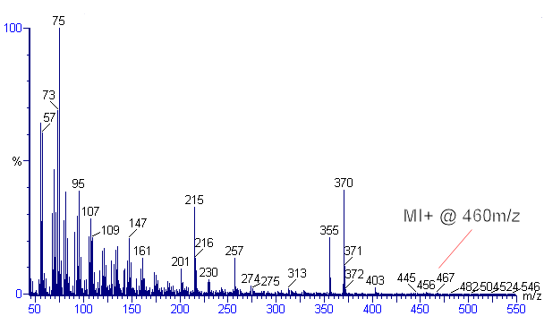
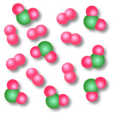
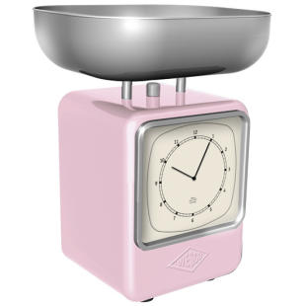


Mass Spectrometry (MS)
A very expensive balance
Proton
-H⁺
-H⁺
-H⁺
-H⁺
-H⁺
-H⁺
-H⁺
-H⁺
-H⁺
: (m/z, ~ # )
: (m/z, ~ # )

Slide 5
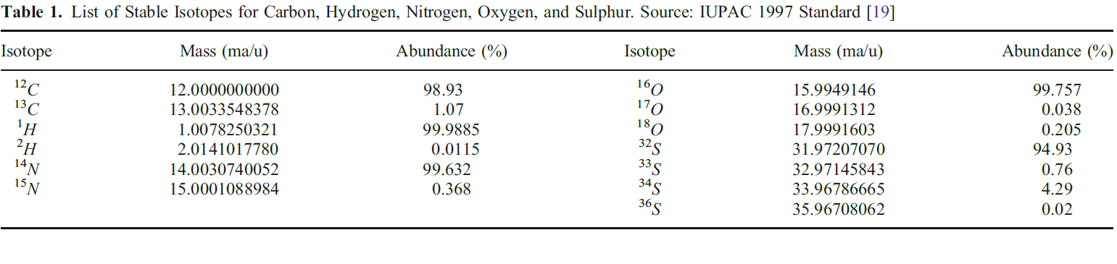
Isotopes
In 1913 Thomson discovered that some atoms had different atomic masses. (107th anniversary of mass spectrometry)
Elemental isotopes: variants of atoms with different number of neutrons
C, H, N, O, S are poly-isotopic elements which are incorporated in biomolecules
Mass expressed in dalton (Da) = 1/12 of a ¹²C atom (approx. 1 neutron)

Slide 6
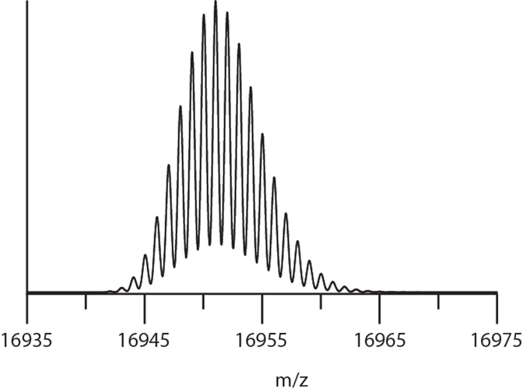
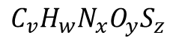
Review of masses
$$C_{v}H_{w}N_{x}O_{y}S_{z}$$
Monoisotopic Mass
My favorite!
Theoretical computation
$$M_{Mono}=vM_{{}_{}^{12}C}+wM_{{}_{}^{1}H}+xM_{{}_{}^{14}N}+yM_{{}_{}^{16}O}+zM_{{}_{}^{32}S}$$
Practical estimation
${\hat{M}}_{Mono}=\text{mass} \text{observed} \text{in} \text{a} \text{spectrum}$ of the lightest isotope + error margin
- Constant of nature – based on elemental monoisotopic masses
- Often not observed in top-down proteomics experiments

Slide 7
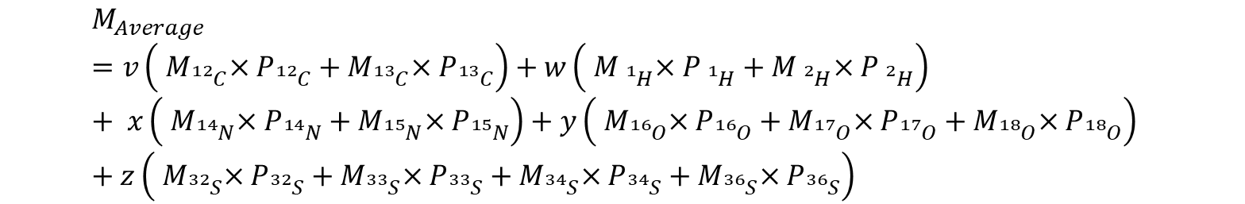
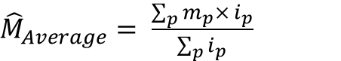
Review of masses
$$C_{v}H_{w}N_{x}O_{y}S_{z}$$
Average Mass
Accumulates error!
Theoretical computation
$$M_{Average}=v\left({ M}_{{}_{}^{12}C}×P_{{}_{}^{12}C}+{ M}_{{}_{}^{13}C}×P_{{}_{}^{13}C}\right)+w\left({ M}_{{}_{}^{1}H}×P_{{}_{}^{1}H}+{ M}_{{}_{}^{2}H}×P_{{}_{}^{2}H}\right) + x\left({ M}_{{}_{}^{14}N}×P_{{}_{}^{14}N}+{ M}_{{}_{}^{15}N}×P_{{}_{}^{15}N}\right)+y\left({ M}_{{}_{}^{16}O}×P_{{}_{}^{16}O}+{ M}_{{}_{}^{17}O}×P_{{}_{}^{17}O}+{ M}_{{}_{}^{18}O}×P_{{}_{}^{18}O}\right) +z\left({ M}_{{}_{}^{32}S}×P_{{}_{}^{32}S}+{ M}_{{}_{}^{33}S}×P_{{}_{}^{33}S}+{ M}_{{}_{}^{34}S}×P_{{}_{}^{34}S}+{ M}_{{}_{}^{36}S}×P_{{}_{}^{36}S}\right)$$
Practical estimation
${\hat{M}}_{Average}= \frac{\sum_{p}{m_{p}× i_{p}}}{\sum_{p}{i_{p}}}$
- Not a constant of nature – based on an estimate of the isotope abundances
- Spectral accuracy influences the observed average mass

Slide 8
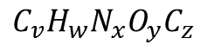
Review of masses
$$C_{v}H_{w}N_{x}O_{y}C_{z}$$
Most abundant mass
A new hope?
Theoretical computation
$$M_{MostAb}⇒\text{No} \text{straightforward} \text{equation}$$
Practical estimation
${\hat{M}}_{MostAb}=\text{mass} \text{observed} \text{in} \text{a} \text{spectrum}$ with best snr + error margin
- More robust towards assumptions – not a common practice in software tools
- Poor ion statistics can select the wrong peak as most abundant
Claesen et al., Anal. Chem., 2015.

Slide 9
The questions that we want to address:
Can we compute exact center-masses of the most abundant peak?
Can we find a relation between the mass of the most abundant peak and the monoisotopic mass to make this concept interoperable with other bioinformatics tools?
Can we robustly identify the most abundant peak given spectral inaccuracies on the peak heights?

Slide 10
Can we predict the monoisotopic mass based on the most abundant mass?
Use BRAIN to compute the aggregated isotope distribution and exact center-masses for the proteins
Use MIND to learn the relation between most abundant masses and the monoisotopic masses
Take a protein database
MIND = MonoIsotopic liNear PreDictor
Claesen et al., J Am Soc Mass Spectrom., 2012.

Slide 11
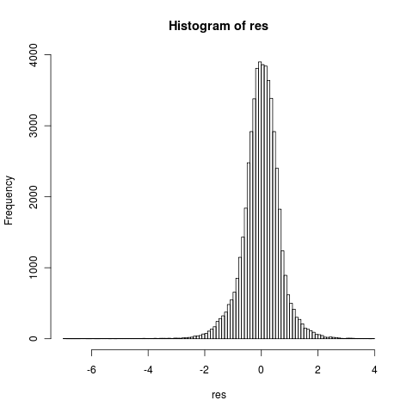
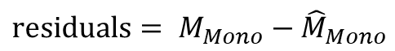
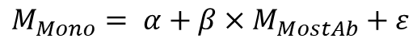
Can we predict the monoisotopic mass based on the most abundant mass?
Model 1:
myoglobine
$$M_{Mono}= α+β×M_{MostAb}+ε$$
Monoisotopic mass (Da)
Most abundant mass (Da)
$$\text{residuals}= M_{Mono}−{\hat{M}}_{Mono}$$
True - Predicted
Dittwald et al., Anal. Chem., 2013.

Slide 12
Can we predict the monoisotopic mass based on the most abundant mass?
Interesting pattern between residuals and most abundant mass!
$$\text{approximate} \text{d}\text{ifference} \text{between} \text{isotopes} ≈1.0025≈1$$

Slide 13
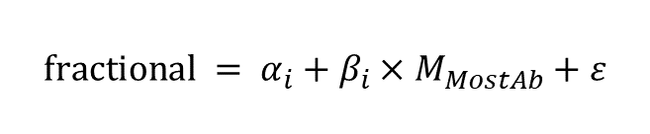
Can we predict the monoisotopic mass based on the most abundant mass?
Model 2:
$$\text{f}\text{ractional} = α_{i}+β_{i}×M_{MostAb}+ε$$
Residuals - rounded residuals
$$M_{MIND}=M_{Mono}+\left(\text{fractional}+k\right) \text{where} k=\left\{−1,0,1\right\}$$
Remember:
Manipulate most abundant mass with multiplication and additions
Found a way to compute the factors for this manipulation
Most abundant mass (Da)

Slide 14
Can we predict the monoisotopic mass based on the most abundant mass?
fraction
residuals
Most abundant mass (Da)
Most abundant mass (Da)
Most abundant mass (Da)

Slide 15
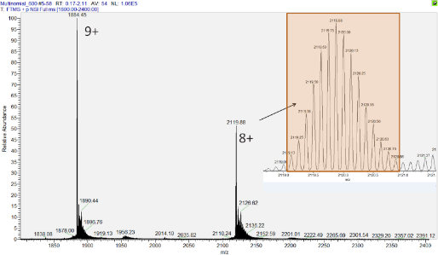
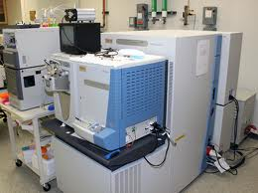
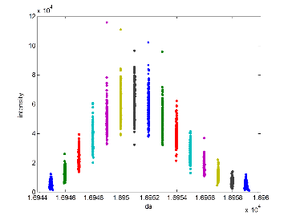
Does MIND work?
200 spectra
Direct infusion of apo-myoglobin
Mono: 16940.96 Da
Avg: 16951.50 Da
Light processing:
Peak extraction
Charge deconvolution
Compute average mass and predict monoisotopic mass and compare with truth

Slide 16

Does MIND work?
8+
[-20.37, -9.02, 1.11 ppm]
[-2.54, -1.97, -1.16 ppm]

Slide 17
Does MIND work?
9+
[-11.46, -4.44, 2.70 ppm]
[-1.43, -0.85, -0.13 ppm]

Slide 18
Does MIND work?
Cytochrome C
[-210.09, -157.35, -103.75] [2.38, 5.48, 8.33] ppm

Slide 19
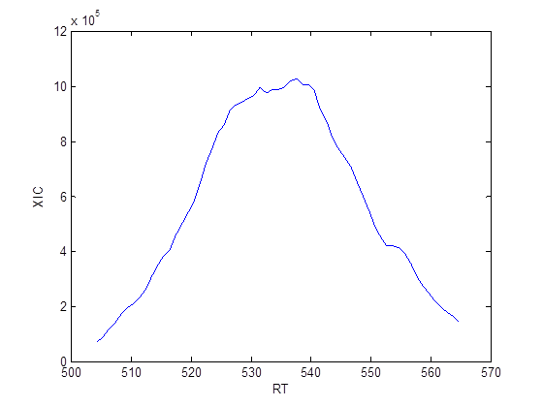
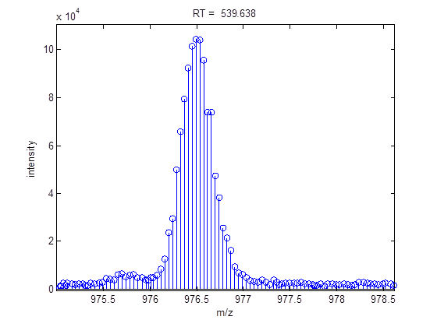
Does MIND work?
Adalimumab light chain on Maxis
15 isotope peaks are selected that are clearly above the noise threshold.

Slide 20
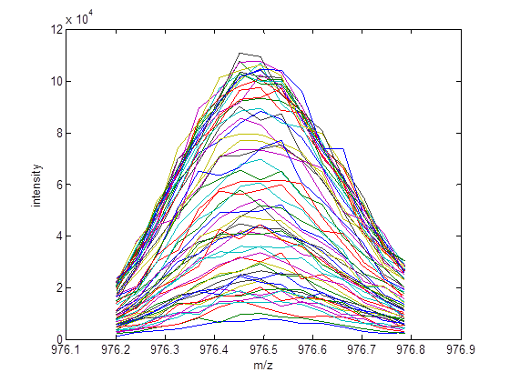
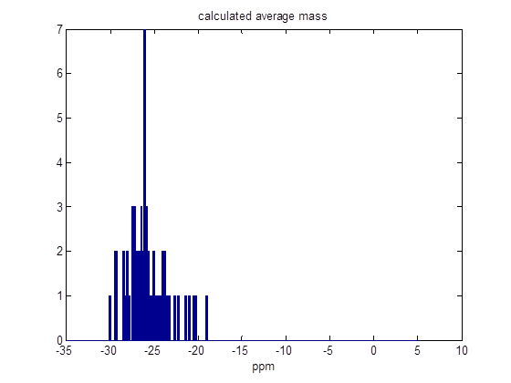
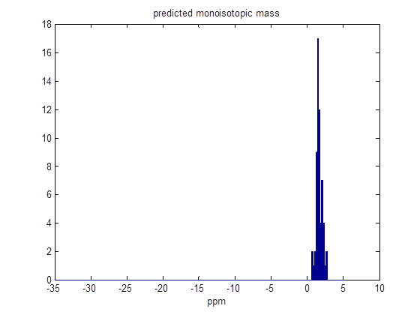
Does MIND work?
Adalimumab

Slide 21
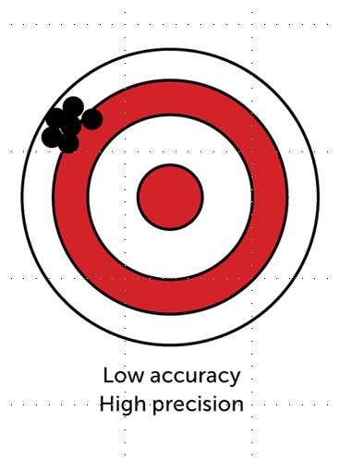
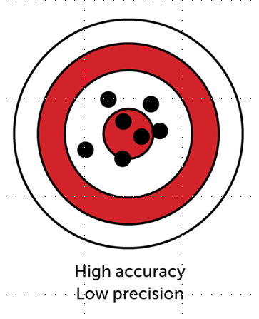
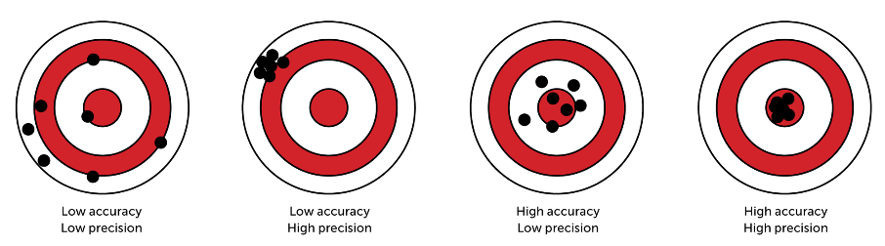
How should we select the most abundant peak?
Average mass
Most abundant mass
Safe zone
Selection rule:
-0.9 < diff < 0.1
→ previous peak
1.1 < diff < 2.1
→ next peak
Count
Theoretical difference (Da)

Slide 22
How should we select the most abundant peak?
Accurate observations for the most abundant mass
prev.
peak
next
peak
Count
Count
Observed difference (Da)
Da

Slide 23
How should we select the most abundant peak?
Simulation by sampling the multinomial distribution with isotope probabilities of myoglobin:
Selection accuracy
Most abundant peak selection
Corrected most abundant peak selection
Number of ions

Slide 24
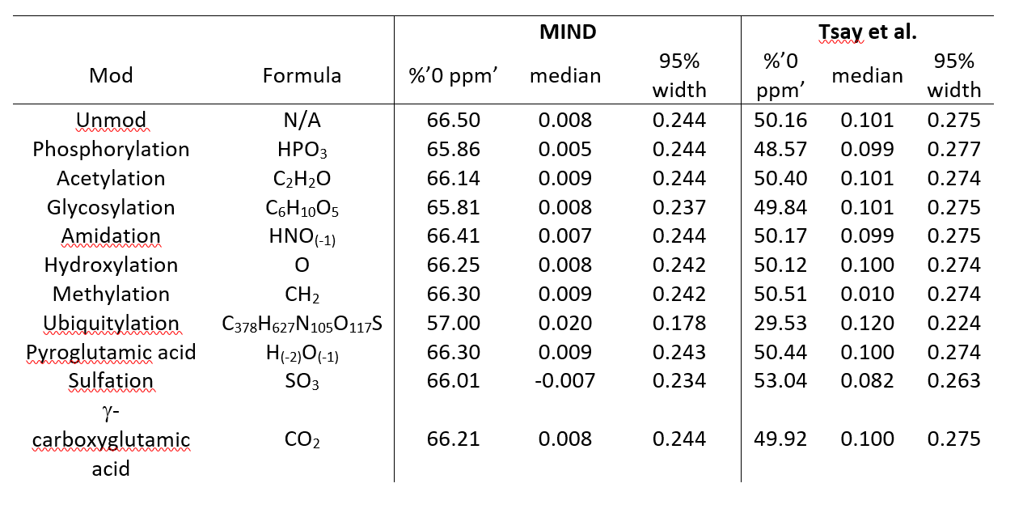
Can MIND handle PTMs?
Chen et al., Anal. Biochem., 2013.

Slide 25
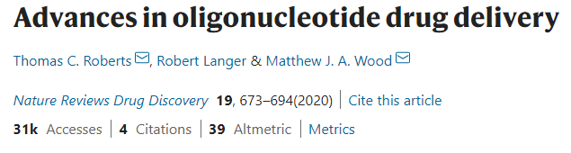

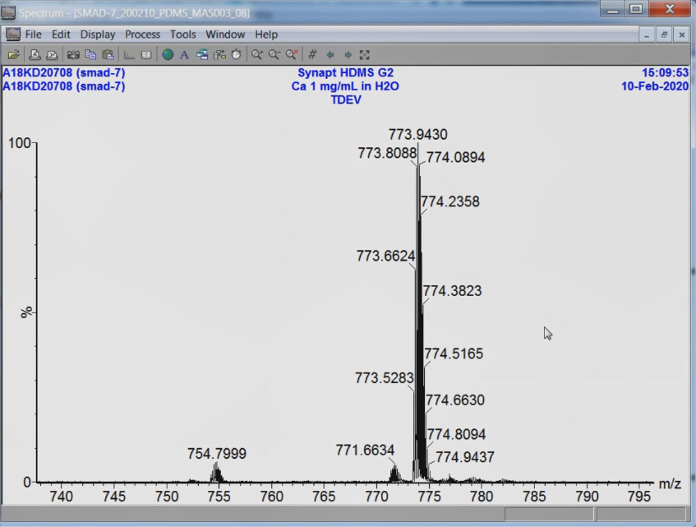

Slide 26
MIND4DNA
Construct virtual oligo’s
All possible combination from 5 nucleotides to 40 nucleotides:
Nucleotide = [C H N O S P]
dAMP = [10 14 5 6 0 1]
dCMP = [ 9 14 3 7 0 1]
dGMP = [10 14 5 7 0 1]
dTMP = [10 15 2 8 0 1]
Polymerize by subtracting H₂O for each phoshpo-diester bound
#combinations = 135681 (remarkably also unique)
Mass range = [1463.24 - 13180.11] Da

Slide 27
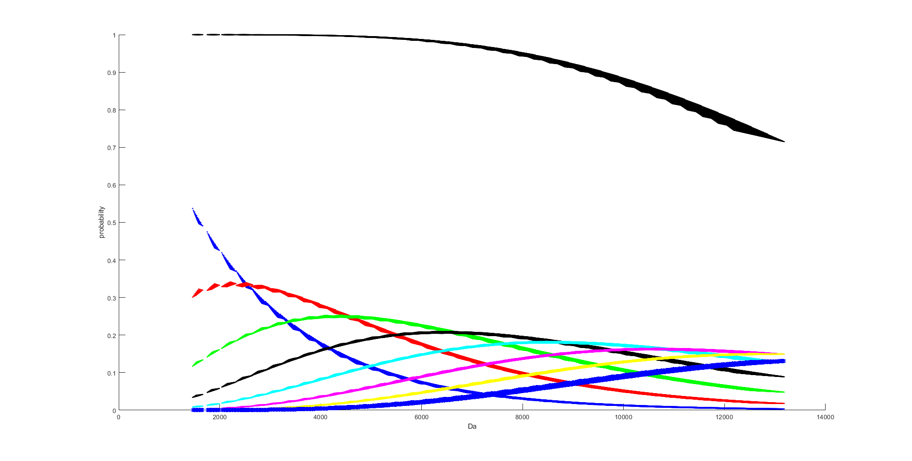
MIND4DNA

Slide 28
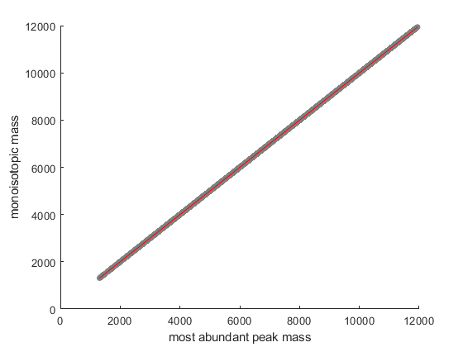
Construct linear model for the entire mass range!!

Slide 29
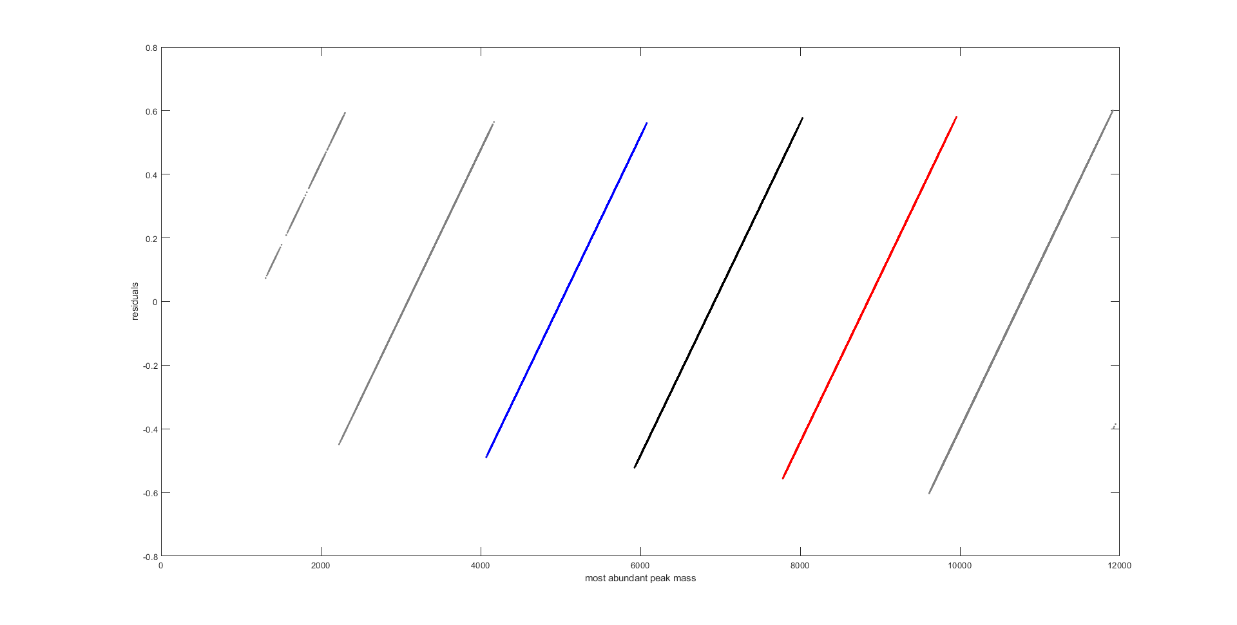
MIND4DNA
Much simpler pattern for DNA because not sulphur!
+ 0.5
- 0.5
Oligo could be on the red or black line!

Slide 30
MIND4DNA
Intervals to switch piecewise linear model?
Sliding window approach to determine the dependency of most abundant mass on off-by-one-dalton error (bandwidth = 50 Da)
100%
100%
Error on a validation dataset

Slide 31
To conclude!
Approach to robustly select the theoretical most abundant peak
Very fast method to predict the monoisotopic mass based on the most abundant mass
Probabilities are associated with -1, 0, or +1 addition
Works equally good for the ten most common PTMs
Allows you to use the mass accuracy you initially paid for.
Take home question is…..

Slide 32
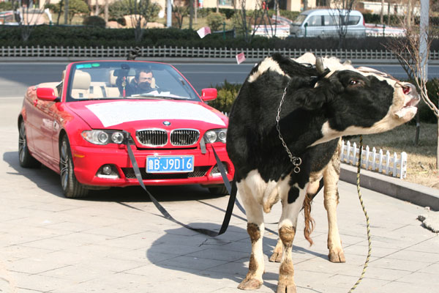

Slide 33






Acknowledgments
Geert Baggerman
Piotr Dittwald
Jef Hooyberghs
Frederik Lermyte
Michał Ciach
Peter B. O’Connor
Anna Gambin
Kris Laukens
Frank Sobott
Jürgen Claesen
Tomasz Burzykowski

